Slide 1
Chapter 11: File System Implementation

Slide 2
Chapter 11: File System Implementation
File-System Structure
File-System Implementation
Directory Implementation
Allocation Methods
Free-Space Management
Efficiency and Performance
Recovery
Log-Structured File Systems
NFS
Example: WAFL File System

Slide 3
Objectives
To describe the details of implementing local file systems and directory structures
To describe the implementation of remote file systems
To discuss block allocation and free-block algorithms and trade-offs

Slide 4
11.1 File-System Structure
File structure
  Logical storage unit
  Collection of related information
File system resides on secondary storage (disks)
File system organized into layers
File control block(FCB) – storage structure consisting of information about a file

Slide 5
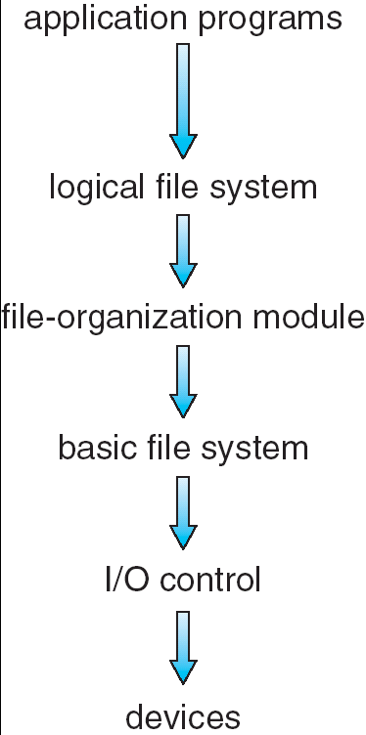
Layered File System
Logical file system
  Manage metadata information(File-system structure)
  Manage directory structure (symbolic file name, FCB)
File-organization module
  Concern files and their logical blocks
  Translate logical block addresses to physical block addresses for the basic file system to transfer
Basic file system
  Generic commands to the appropriate device driver to read and write physical blocks on the disk
  Each physical block is identified by its numeric disk address (e.g. drive 1, cylinder 73,track 2, sector 10)
I/O control
  Device drivers
  Interrupt handler

Slide 6
I/O control
  Device drivers
  Interrupt handler
Basic file system
  Generic commands to the appropriate device driver to read and write physical blocks on the disk
  Each physical block is identified by its numeric disk address (e.g. drive 1, cylinder 73,track 2, sector 10)
File-organization module
  Concern files and their logical blocks,
  Translate logical block addresses to physical block addresses for the basic file system to transfer
Logical file system
  Manage metadata information (File-system structure)
  Manage directory structure (symbolic file name, FCB)

Slide 7
11.2 File-System Implementation
11.2.1 Overview
Several on-disk and in-memory structures are used to implement a file system.
These structures vary depending on the operating system and the file system

Slide 8
On-Disk File System Structures
On disk, the file system may contain information about
  How to boot an operating system stored there,
  The total number of blocks
  The number and location of free blocks
  The directory structure and individual files

Slide 9
On-Disk File System Structures (Cont)
A boot control block (per volume)
A volume control block (per volume)
  Superblock
  master file table
A directory structure per file system
A per-file FCB

Slide 10
On-Disk File System Structures（UNIX）
引导块（boot block）
  占据文件系统的开始，一般是一个扇区
  含有被读入机器中起引导或初启OS的引导代码
  每个文件系统都有一个引导块（可能是空的）
超级块 ( volume control block, directory structure )
  文件系统的规模（多大空间）
  文件系统空闲块的数目
  文件系统中可用的空闲块表（链表的表头）
  文件系统中下一个空闲块的下标
  索引节点表的大小
  文件系统中空闲索引节点的数目
  文件系统中空闲索引节点表
  空闲索引节点表中下一个空闲索引节点的下标
  空闲块表的锁字段和空闲索引节点表锁字段
  指明超级块被修改过的标记
索引节点表 (per-file FCB )
数据块
引导块
超级块
索引节点表
数据块

Slide 11
On-Disk File System Structures (Cont)
A boot control block (per volume)
  Contain information needed by the system to boot an operating system from that volume.
  If the disk does not contain an operating system, this block can he empty.
  It is typically the first block of a volume.
  In UFS, it is called the boot block;
  in NTFS, it is the partition boot sector.

Slide 12
On-Disk File System Structures (Cont)
A volume control block (per volume)
  Contains volume (or partition) details, such as
    the number of blocks in the partition,
    size of the blocks,
    free-block count and free-block pointers,
    free FCB count and FCB pointers.
  In UFS, this is called a superblock;
  In NTFS, it is stored in the master file table.

Slide 13
On-Disk File System Structures (Cont)
A directory structure per file system
  Used to organize the files.
  In UFS, this includes file names associated inode numbers.
  In NTFS it is stored in the master file table.

Slide 14
On-Disk File System Structures (Cont)
A per-file FCB
  contains many details about the file, including
    file permissions
    Ownership
    Size
    location of the data blocks.
  In UFS, this is called the inode.
  In NTFS, this information is actually stored within the master file table, which uses a relational database structure, with a row per file.

Slide 15
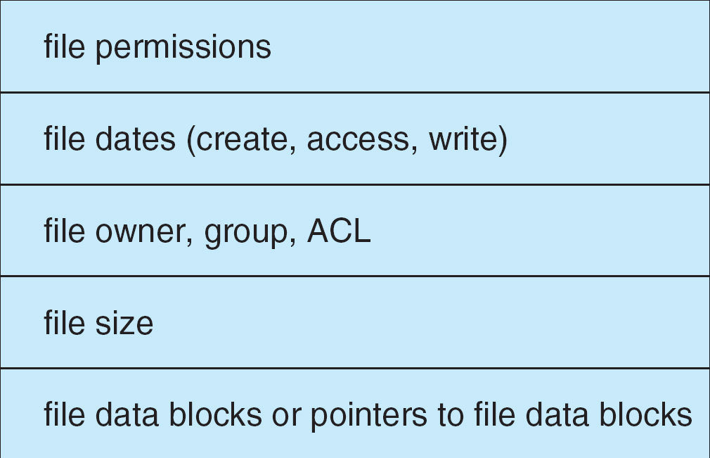
A Typical File Control Block

Slide 16

Inode in UNIX

Slide 17
In-Memory File System Structures
The in-memory information is used for both file-system management and performance improvement via caching. The data are loaded at mount time and discarded at dismount.
In-memory mount table
In-memory directory-structure
System-wide open-file table
Per-process open-file table

Slide 18
In-Memory File System Structures(Cont)
In-memory mount table
  contains information about each mounted volume.
In-memory directory-structure
  cache holds the directory information of recently accessed directories. (For directories at which volumes are mounted, it can contain a pointer to the volume table.)
System-wide open-file table
  contains a copy of the FCB of each open file, as well as other information.
Per-process open-file table
  contains a pointer to the appropriate entry in the system-wide open-file table, as well as other information.

Slide 19
In-Memory File System Structures(Cont)
The following figure illustrates the necessary file system structures provided by the operating systems.
Figure 12-3(a) refers to opening a file.
Figure 12-3(b) refers to reading a file.

Slide 20

In-Memory File System Structures

Slide 21
UNIX实例
Per-process open-file table
File table (System-wide)
Index-nodes table（FCB）
fd=open(filename)
num=read(fd, buf,num)

Slide 22
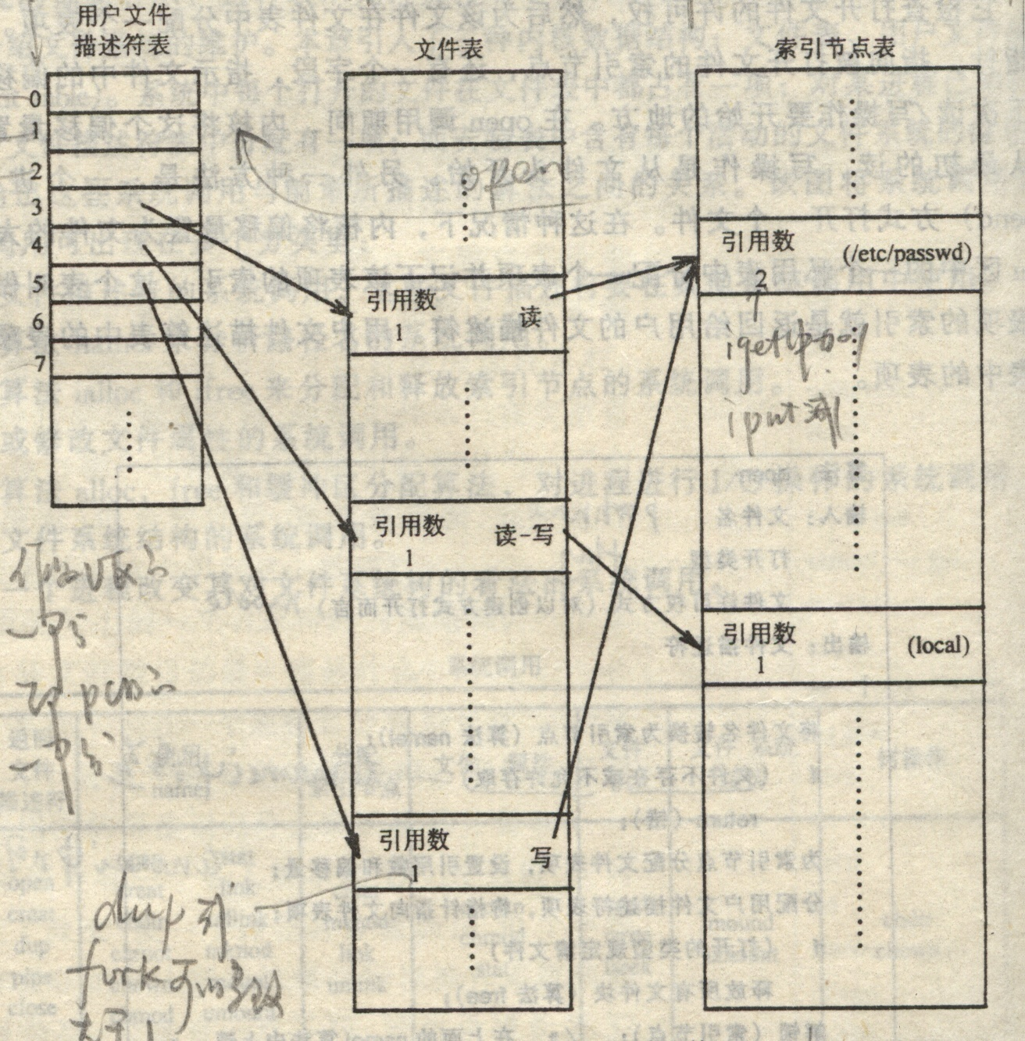
文件的打开过程

Slide 23
11.2.2 Partition and Mounting
A disk can be sliced into multiple partitions
A volume can span multiple partitions on multiple disks (e.g RAID)
Each partition can be either :
  "raw“-- containing no file system, disk is used where no file system is appropriate.
    UNIX swap space can use a raw partition, as it uses its own format
    some databases use raw disk and format the data to suit their needs.
  "cooked“ --containing a file system

Slide 24
Partition and Mounting (Cont.)
Boot information
  Can be stored in a separate partition. It has its own format, since at boot time the system does not have file-system device drivers loaded and therefore cannot interpret the file-system format
  Usually a sequence series of blocks, loaded as an image into memory
Dual-booted system– Multiple operating systems can be installed on such a system
  boot loader:
    understands multiple operating systems and multiple file systems
    occupy the boot space.

Slide 25
Partition and Mounting (Cont)
Root partition
  Contains the operating-system kernel and sometimes other system files
  Mounted at boot time
  Other volumes can be automatically mounted at boot or Manually mounted later
In-memory mount table structure
    contains information about each mounted volume.
Microsoft Windows-based systems mount each volume in a separate name space, denoted by a letter and a colon.
On UNIX, file systems can be mounted at any directory--mount point

Slide 26
11.2.3 Virtual File Systems
Virtual File Systems (VFS) provide an object-oriented way of implementing file systems.
VFS allows the same system call interface (the API) to be used for different types of file systems.
The API is to the VFS interface, rather than any specific type of file system.

Slide 27

Schematic View of Virtual File System

Slide 28
11.3 Directory Implementation
The selection of directory-allocation and directory-management algorithms significantly affects the efficiency, performance, and reliability of the file system
Linear list of file names with pointer to the data blocks.
  simple to program
  time-consuming to execute
    finding a file requires a linear search.
Hash Table – linear list with hash data structure.
  decreases directory search time
  collisions – situations where two or more file names hash to the same location
  fixed size, and the dependence of the hash function on that size

Slide 29
11.4 Allocation Methods
An allocation method refers to how disk blocks are allocated for files
物理文件的结构
Objective
  有效地利用外存空间（额外的磁盘空间、碎片）
  提高对文件的访问速度（随机存取）
  保证可靠性（是否容易导致文件的损坏）
  实现难度
Methods：
  Contiguous allocation
  Linked allocation
  Indexed allocation

Slide 30
11.4.1 Contiguous Allocation
Each file occupies a set of contiguous blocks on the disk

Slide 31

Contiguous Allocation of Disk Space

Slide 32
Contiguous Allocation (Cont)
Each file occupies a set of contiguous blocks on the disk
Simple – only starting location (block #) and length (number of blocks) are required
Random access
Wasteful of space (dynamic storage-allocation problem)
  External fragmentation
    Compact---compacts all free space into one contiguous space
To determine how much space is needed for a file before it is created
Files cannot grow
分配方法：best fit， first fit， worst fit， next fit

Slide 33
Contiguous Allocation (Cont)
Mapping from logical to physical address
假设每个磁盘块的大小(block size)为512 bytes
给定要访问文件的逻辑地址LA，则
Q
LA/512
R
  LA除以512（block size），商为Q，余数为R
  (LA, Q, R的含义)
  starting address=文件的第一个磁盘块号
  Block to be accessed =starting address +Q
  Displacement into block = R

Slide 34
Extent-Based Systems
Many newer file systems (i.e. Veritas file system) use a modified contiguous allocation scheme
Extent-based file systems allocate disk blocks in extents
An extent is a contiguous block of disks
  Extents are allocated for file allocation
  A file consists of one or more extents.
External fragmentation

Slide 35
11.4.2 Linked Allocation
Each file is a linked list of disk blocks: blocks may be scattered anywhere on the disk.
block =
pointer

Slide 36

Linked Allocation
隐式链接

Slide 37
Linked Allocation (Cont.)
Simple – need only starting address
No external fragmentation
The size of a file need not be declared when that file is created
Need space to stored pointers
No random access
Lower reliability---the pointers scatter all over the disk, they will be ease to lose or be damaged

Slide 38
Linked Allocation (Cont.)
Mapping from logical to physical address
假设每个磁盘块的大小(block size)为512 bytes ，其中1个字节作为地址，其余511字节存储数据
Q
LA/511
R
  LA除以511（block size），商为Q，余数为R
  Block to be accessed is the Qth block in the linked chain of blocks representing the file.
  Displacement into block = R

Slide 39
Linked Allocation (Cont.)
File-allocation table (FAT) – disk-space allocation used by MS-DOS、Windows and OS/2.
实质上就是将前面介绍的隐式链接中的Linked域独立出来，构成一个FAT表，专门用于实现磁盘块之间的链接。
又称为显示链接；

Slide 40

File-Allocation Table
FAT有关的文件系统
  FAT 12
  FAT 16
  FAT 32
FAT表的大小
块大小的影响

Slide 41

MS-DOS Disk Layout

Slide 42

在分区上创建的FAT32文件系统结构

Slide 43
Linked Allocation (Cont.)
某磁盘文件区256GB ，回答下列问题：（列出解题步骤）
1、如果采用FAT32文件系统，假定每个磁盘块大小为1KB，问FAT表需要占用几个磁盘块？
2、如果采用FAT32文件系统，每个磁盘块最小可以是多少字节？
3、如果采用FAT16系统，在磁盘空间不变的情况下，每个磁盘块最小可以是多少字节？

Slide 44
Linked Allocation (Cont.)
1、
磁盘总字节数：2⁸*2³⁰ = 2³⁸字节
磁盘总块数：2³⁸/2¹⁰ = 2²⁸ 块
FAT表所占空间（字节数）： 2²⁸ *4 字节=2³⁰ 字节
采用FAT所占盘块数为： ： 2³⁰ / 2¹⁰ 块=2²⁰块
2、磁盘总盘字节数： 2³⁸字节
磁盘的总块数上限： 2³²块
每个磁盘块最小应该为： 2³⁸/ 2³²=2⁶字节，即64bytes
3、
磁盘总盘字节数： 2³⁸字节
磁盘的总块数上限： 2¹⁶块
每个磁盘块的大小最小应该为： 2³⁸/ 2¹⁶=2²² 字节= 2² * 2²⁰ 字节，即4MB

Slide 45
11.4.3 Indexed Allocation
Brings all pointers together into the index block.
Logical view.
index table

Slide 46

Example of Indexed Allocation

Slide 47
Indexed Allocation (Cont.)
Random access
The size of a file need not be declared when that file is created
No external fragmentation
waste space
  dynamic access without external fragmentation, but have overhead of index block.
  The pointer overhead of the index block is generally greater than that of linked allocation

Slide 48
Indexed Allocation (Cont.)
Mapping from logical to physical
  In a file of maximum size of 256K bytes, and block size of 512 bytes. We need only 1 block for index table.
  (why? 文件大小256K bytes (2¹⁸ bytes)，一个磁盘块可存储512 bytes (2⁹ bytes)，因此，索引块需要2¹⁸/2⁹=2⁹项。即该文件需要512个磁盘块存储其文件内容，作为索引块的一个磁盘块可以存储512项)
Q
LA/512
R
  LA除以512（block size），商为Q，余数为R
Q = displacement into index table
R = displacement into block

Slide 49
Indexed Allocation – Mapping (Cont.)
Index block management
  Linked scheme – Link blocks of index table (no limit on size).
  Multilevel index
    e.g. Two-level index (maximum file size is 512³)
  Combined scheme
    UNIX
      Direct blocks, single indirect, double indirect, triple indirect

Slide 50
Indexed Allocation – Mapping (Cont.)
Linked scheme – Link blocks of index table (no limit on size).
假设每个磁盘块的大小(block size)为512 bytes
索引块中一个字节(项)作为索引块之间的链接地址，其余511项存放数据块号
Q₁
LA / (512 x 511)
R₁
  Q₁ = block of index table
  R₁ is used as follows:
Q₂
R₁ / 512
R₂
  Q₂ = displacement into block of index table
  R₂ = displacement into block of file
  注：如果索引块中一项为一个字节时寻址范围太小，可以采用采用多个字节，或者增大磁盘块的大小

Slide 51
Indexed Allocation – Mapping (Cont.)
Multilevel index

outer-index
index table
file

Slide 52
Indexed Allocation – Mapping (Cont.)
假设每个磁盘块的大小(block size)为512 bytes
Two-level index (maximum file size is 512³)
Q₁
LA / (512 x 512)
R₁
  Q₁ = displacement into outer-index
  R₁ is used as follows:
Q₂
R₁ / 512
R₂
  Q₂ = displacement into block of index table
  R₂ = displacement into block of file

Slide 53
Combined Scheme: UNIX (4K bytes per block)

Slide 54
习题 P448
11.6 Consider a file system on a disk that has both logical and physical block sizes of 512 bytes.
Assume that the information about each file is already in memory.
For each of the three allocation strategies (contiguous, linked, and indexed), answer these questions:
a. How is the logical-to-physical address mapping accomplished in this system? (For the indexed allocation, assume that a file is always less than 512 blocks long.)
b. If we are currently at logical block 10 (the last block accessed was block 10) and want to access logical block 4, how many physical blocks must be read from the disk?

Slide 55
习题 P448参考答案
Answer: Let S be the starting file address (block number).
a. Contiguous. Divide the logical address by 512 with Q and R the resulting quotient and remainder respectively.
  1. Add Q to S to obtain the physical block number. R is the displacement into that block.
  2. 1
b. Linked. Divide the logical physical address by 511 with Q and R the resulting quotient and remainder respectively.
  1. Chase down the linked list (getting Q + 1 blocks). R is the displacement into the last physical block.
  2. 4? (5?)
c. Indexed. Divide the logical address by 512 with Q and R the resulting quotient and remainder respectively.
  1. Get the index block into memory. Physical block address is contained in the index block at location Q. R is the displacement into the desired physical block.
  2. 2

Slide 56
11.5 Free-Space Management
Bit vector (Bit Map)
Linked list (free list)
Grouping
Counting
每种方法的评价指标：
  是否需要额外的磁盘空间？需要多少？
  是否容易找到连续块？
  效率：空间分配与回收的效率

Slide 57
11.5.1 Bit vector (Bit Map)
Bit vector (n blocks)
  Each block is represented by 1 bit
0
1
2
n-1
…
0 ⇒ block[i] occupied (allocated)
1 ⇒block[i] free
bit[i] =

Block number calculation：
(number of bits per word) *
(number of 0-value words) +
offset of first 1 bit

Slide 58
Free-Space Management (Cont.)
Bit map requires extra space
  Example:
block size = 2¹² bytes
disk size = 2³⁰ bytes (1 gigabyte)
n = 2³⁰/2¹² = 2¹⁸ bits (or 32K bytes)
Relative simplicity
Easy to get contiguous files
Bit vectors are inefficient unless the entire vector is kept in main memory (and is written to disk occasionally for recovery needs).
Keeping it in main memory is possible for smaller disks but not necessarily for larger ones.
实现：位示图存储在磁盘上，检索时装入主存；
位示图在磁盘上的位置放在超级块中；

Slide 59
例题
某磁盘文件区16GB ,每个磁盘块大小为1KB，回答下列问题：（列出解题步骤）
如果空闲存储空间采用位示图（位向量）管理方法，那么位示图需要占用多少个盘块？

Slide 60
例题—参考答案
磁盘总盘字节数 (16GB) ：16* 2³⁰ =2³⁴字节
磁盘总块数： 2³⁴ 字节/2¹⁰ (字节/块)= 2²⁴ 块
存储位示图需要的位数： 2²⁴ 位
存储位示图需要的字节数：2²⁴位 /8(位/字节)=2²¹字节
位示图所占盘块数： 2²¹字节/2¹⁰ (字节/块)=2¹¹块

Slide 61
11.5.2 Linked list
Linked list (free list)
  将所有空闲磁盘块用链表链接起来，并将指向第一个空闲块的头指针保存在磁盘的特殊位置（Super block），同时也缓存在内存中；
  Cannot get contiguous space easily
  No waste of space（不占用额外的磁盘空间）
实现：链表的头部放在超级块中；

Slide 62

Linked Free Space List on Disk

Slide 63
11.5.3 Grouping
Grouping （UNIX使用的 “成组链接法”）
  对空闲链表的改进；
  将n个空闲块分成一组，每组中的第一块或最后一块保存下一组的空闲块地址，依次类推；
  第一组的块地址保存在一个特殊空闲块中；
  No waste of space（不占用额外的磁盘空间）
  Cannot get contiguous space easily
  与链表法不同，该方法容易找到大量的空闲块；
  类似于站队，队长负责记忆第一排人员的编号（名字），队首负责下一排人员的编号（名字），类推；
  新来的队员加入到最后一排的最后一个；
  出去的队员从第一排的最后一个离开；当第一排的派头被派出时，首先把她所记忆的下一排的人员的信息告诉队长；
  队长在超级块中；

Slide 64
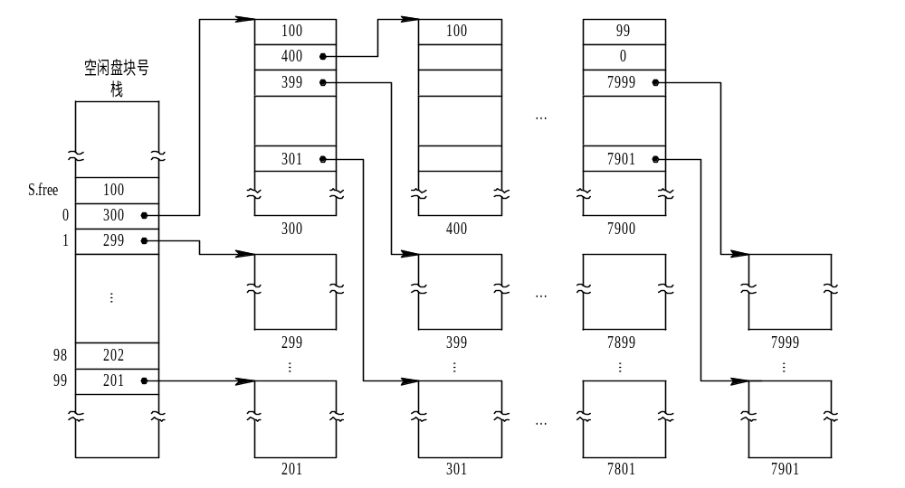
Grouping (Cont.)
空闲盘块的组织

Slide 65
11.5.4 Counting
Counting
  建立一个类似于分区内存管理中的分区表；
  每个表项记录第一块的地址和与第一块连续的空闲块的数量；
  容易找到连续的空间
  需要额外的空间

Slide 66
Counting
requires extra space（磁盘上有一个“空闲盘块表”）；
为磁盘上的每个空闲连续存储空间中的磁盘块建立一个表项 ；
适合连续文件空间的连续分配；
序号 | 第一空闲盘块表 | 空闲盘块数
1 | 1 | 4
2 | 9 | 3
3 | …… | ……

Slide 67
Free-Space Management---problems
Need to protect:
  Pointer to free list
  Bit map
    Must be kept on disk
    Copy in memory and disk may differ
    Cannot allow for block[i] to have a situation where bit[i] = 1 in memory and bit[i] = 0 on disk
    Solution:
      Set bit[i] = 1 in disk
      Allocate block[i]
      Set bit[i] = 1 in memory

Slide 68
11.6 Efficiency and Performance
Efficiency dependent on:
  disk allocation and directory algorithms
  types of data kept in file’s directory entry
Performance
  disk cache – separate section of main memory for frequently used blocks
  free-behind and read-ahead – techniques to optimize sequential access
  improve PC performance by dedicating section of memory as virtual disk, or RAM disk

Slide 69
11.6.1 Efficiency
Efficiency dependent on:
  disk allocation and directory algorithms
  types of data kept in file’s directory entry（FCB中项越多，效率越低，但方便）
  UNIX中，索引节点预先分配
    即使空闲也占用一定的空间；
    如果集中分配在文件起始位置，可能与文件距离比较远，增大寻道时间；
    如果预先分配在整个磁盘空间中，可以使文件数据与其对应的索引节点存放在一起，降低寻道时间；
  为了备份的需要（增量备份） ，文件的“最近访问时间”需要保存，增加了文件目录的读写频率；（需要优化）

Slide 70
11.6.2 Performance
Performance
  disk cache – separate section of main memory for frequently used blocks
  同步写与异步写；同步读与异步读；
  free-behind and read-ahead – techniques to optimize sequential access
    考虑到文件大部分都是顺序访问，因此新读入的页要覆盖先前的页，而且新读入的页面的后面几页可能也要访问，因此采用立即释放与提前预读技术；
    要让磁盘块在内存中驻留尽量长的时间；
  improve PC performance by dedicating section of memory as virtual disk, or RAM disk.
    尽量减少磁盘的访问频率；

Slide 71

Various Disk-Caching Locations

Slide 72
Page Cache
A page cache caches pages rather than disk blocks using virtual memory techniques
Memory-mapped I/O uses a page cache
Routine I/O through the file system uses the buffer (disk) cache
This leads to the following figure

Slide 73
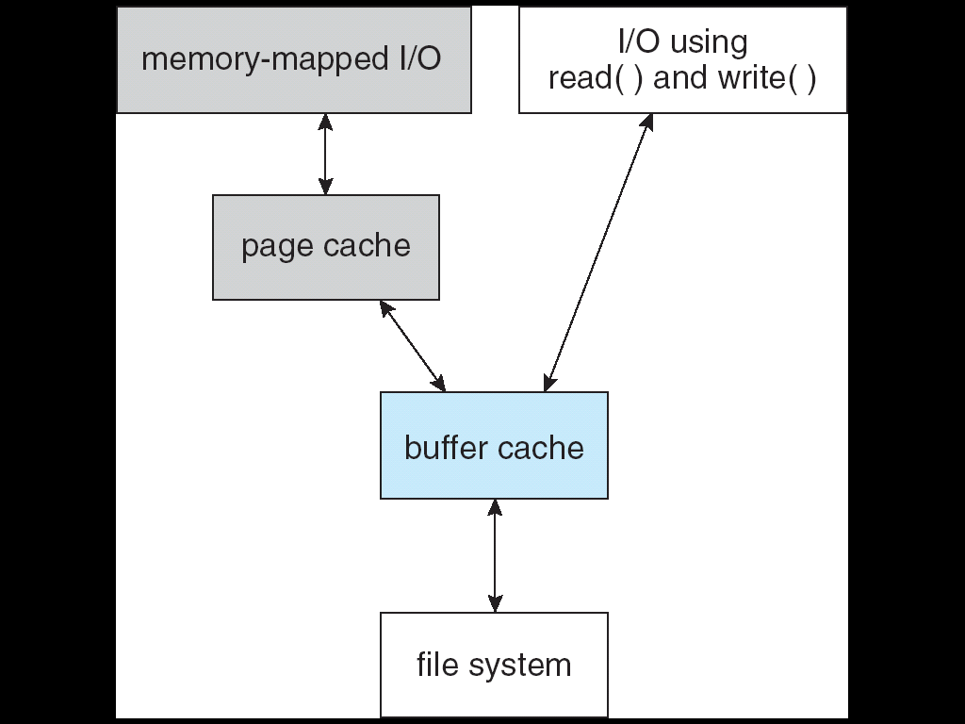
I/O Without a Unified Buffer Cache

Slide 74
Unified Buffer Cache
A unified buffer cache uses the same page cache to cache both memory-mapped pages and ordinary file system I/O

Slide 75
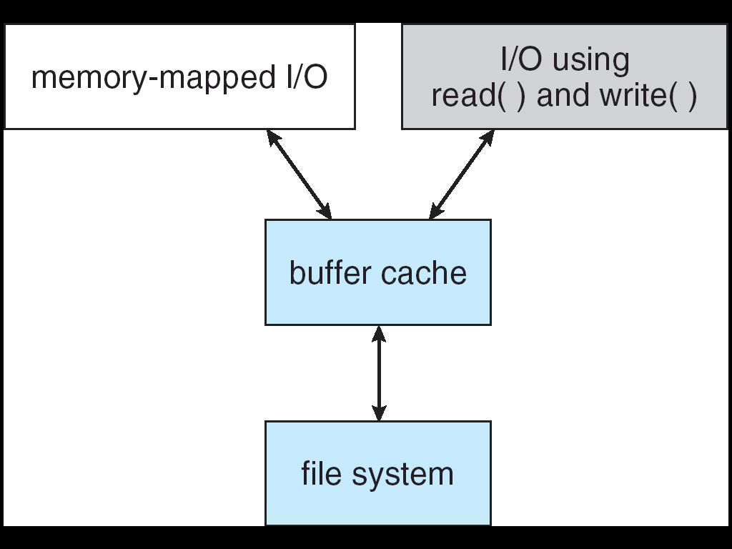
I/O Using a Unified Buffer Cache

Slide 76
11.7 Recovery
Consistency checking – compares data in directory structure with data blocks on disk, and tries to fix inconsistencies
Use system programs to back up data from disk to another storage device (floppy disk, magnetic tape, other magnetic disk, optical)
Recover lost file or disk by restoring data from backup

Slide 77
11.8 Log Structured File Systems
Log structured (or journaling) file systems record each update to the file system as a transaction
All transactions are written to a log
  A transaction is considered committed once it is written to the log
  However, the file system may not yet be updated
The transactions in the log are asynchronously written to the file system
  When the file system is modified, the transaction is removed from the log
If the file system crashes, all remaining transactions in the log must still be performed

Slide 78
11.9 The Sun Network File System (NFS)
An implementation and a specification of a software system for accessing remote files across LANs (or WANs)
The implementation is part of the Solaris and SunOS operating systems running on Sun workstations using an unreliable datagram protocol (UDP/IP protocol and Ethernet

Slide 79
NFS (Cont.)
Interconnected workstations viewed as a set of independent machines with independent file systems, which allows sharing among these file systems in a transparent manner
  A remote directory is mounted over a local file system directory
    The mounted directory looks like an integral subtree of the local file system, replacing the subtree descending from the local directory
  Specification of the remote directory for the mount operation is nontransparent; the host name of the remote directory has to be provided
    Files in the remote directory can then be accessed in a transparent manner
  Subject to access-rights accreditation, potentially any file system (or directory within a file system), can be mounted remotely on top of any local directory

Slide 80
NFS (Cont.)
NFS is designed to operate in a heterogeneous environment of different machines, operating systems, and network architectures; the NFS specifications independent of these media
This independence is achieved through the use of RPC primitives built on top of an External Data Representation (XDR) protocol used between two implementation-independent interfaces
The NFS specification distinguishes between the services provided by a mount mechanism and the actual remote-file-access services

Slide 81

Three Independent File Systems

Slide 82
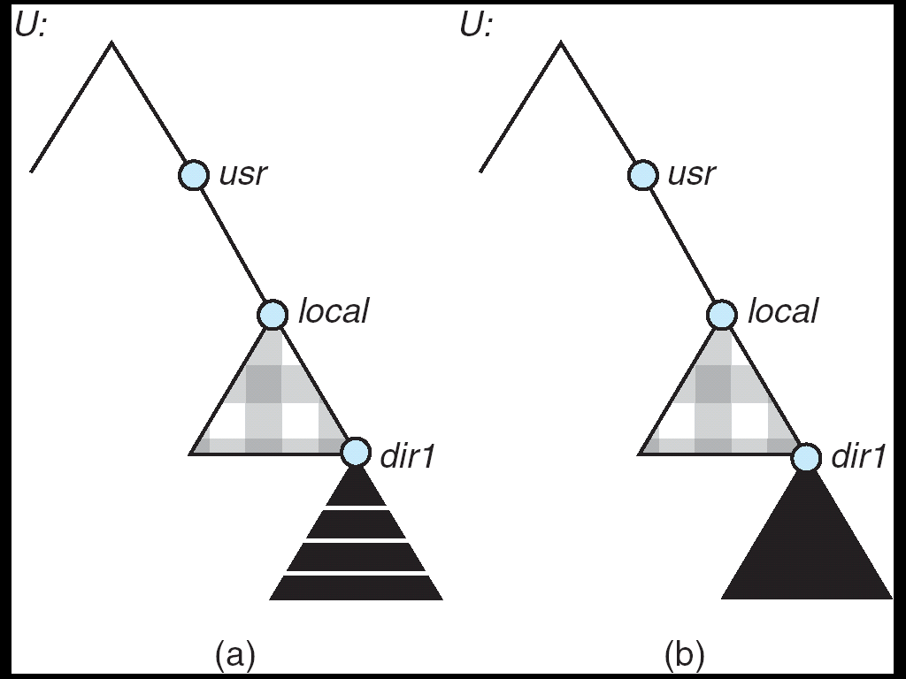
Mounting in NFS
Mounts
Cascading mounts

Slide 83
11.9.2 NFS Mount Protocol
Establishes initial logical connection between server and client
Mount operation includes name of remote directory to be mounted and name of server machine storing it
  Mount request is mapped to corresponding RPC and forwarded to mount server running on server machine
  Export list – specifies local file systems that server exports for mounting, along with names of machines that are permitted to mount them
Following a mount request that conforms to its export list, the server returns a file handle—a key for further accesses
File handle – a file-system identifier, and an inode number to identify the mounted directory within the exported file system
The mount operation changes only the user’s view and does not affect the server side

Slide 84
11.9.3 The NFS Protocol
Provides a set of remote procedure calls for remote file operations. The procedures support the following operations:
  searching for a file within a directory
  reading a set of directory entries
  manipulating links and directories
  accessing file attributes
  reading and writing files
NFS servers are stateless; each request has to provide a full set of arguments
(NFS V4 is just coming available – very different, stateful)
Modified data must be committed to the server’s disk before results are returned to the client (lose advantages of caching)
The NFS protocol does not provide concurrency-control mechanisms

Slide 85
Three Major Layers of NFS Architecture
UNIX file-system interface (based on the open, read, write, and close calls, and file descriptors)
Virtual File System (VFS) layer – distinguishes local files from remote ones, and local files are further distinguished according to their file-system types
  The VFS activates file-system-specific operations to handle local requests according to their file-system types
  Calls the NFS protocol procedures for remote requests
NFS service layer – bottom layer of the architecture
  Implements the NFS protocol

Slide 86
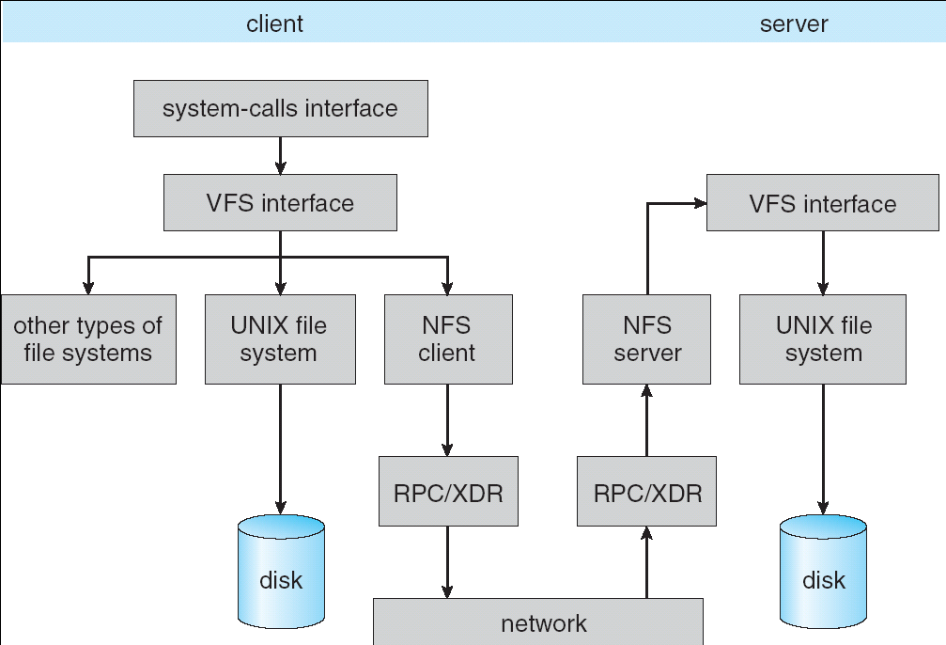
Schematic View of NFS Architecture

Slide 87
11.9.4 NFS Path-Name Translation
Performed by breaking the path into component names and performing a separate NFS lookup call for every pair of component name and directory vnode
To make lookup faster, a directory name lookup cache on the client’s side holds the vnodes for remote directory names

Slide 88
11.9.5 NFS Remote Operations
Nearly one-to-one correspondence between regular UNIX system calls and the NFS protocol RPCs (except opening and closing files)
NFS adheres to the remote-service paradigm, but employs buffering and caching techniques for the sake of performance
File-blocks cache – when a file is opened, the kernel checks with the remote server whether to fetch or revalidate the cached attributes
  Cached file blocks are used only if the corresponding cached attributes are up to date
File-attribute cache – the attribute cache is updated whenever new attributes arrive from the server
Clients do not free delayed-write blocks until the server confirms that the data have been written to disk

Slide 89
11.10 Example: WAFL File System
Used on Network Appliance “Filers” – distributed file system appliances
“Write-anywhere file layout”
Serves up NFS, CIFS, http, ftp
Random I/O optimized, write optimized
  NVRAM for write caching
Similar to Berkeley Fast File System, with extensive modifications

Slide 90
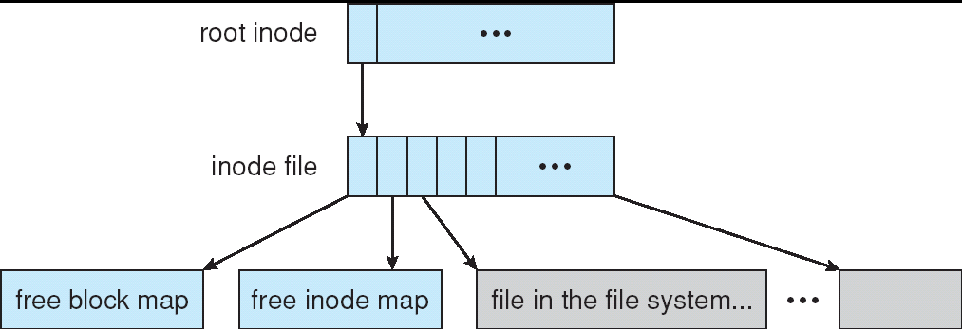
The WAFL File Layout

Slide 91
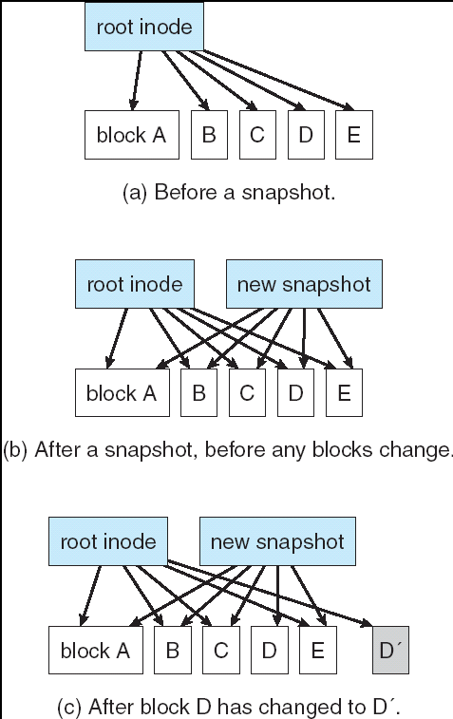
Snapshots in WAFL

Slide 92
11.02

Slide 93
Homework
P447: 2,6,3,8,10
文件目录有哪些实现方法？说明其思想、特点。
说明几种文件分配方式的思想、特点，并掌握相关的计算。
  如逻辑地址到物理地址的映射；
  所需FAT表、索引块等所占磁盘块数的计算等；
说明几种磁盘空闲空间的管理方法的思想及特点(优点及缺点)，并掌握相关的计算。
  如位视图所需磁盘块的计算；
为提高文件系统的性能，可采用哪些措施？

Slide 94
End of Chapter 11

